Slide 1

Leveraging Clustering for
Large-Scale Time Series Forecasting
KDD SS 2026 — University of Vienna
Muhammad Salman Hafeez • Mikhalchevskyi Yurii • Markschies Benjamin Max
Code: github.com/[team-repo]

Slide 2
The Problem: 17,547 Households × 366 Days
17,547
365 → 366
0
MAE
households
train 2023 → predict 2024
exogenous variables
evaluation metric
Task: Predict daily energy consumption for every household for all of 2024
Only input: 2023 daily consumption (no weather, no demographics, no pricing)
Evaluation: Per-household MAE averaged across all 17,547 households
Challenge: Full-year horizon — no access to recent actuals during prediction

Slide 3
The Data Insight That Changed Everything
Year-over-Year Correlation
0.215
Mean Pearson r across
17,547 households
59% of households
correlation < 0.2
Only 2.1% of households
correlation > 0.8
What this means:
Daily 2023 patterns do NOT repeat in 2024. Only seasonal shape and weekly cycles persist. Aggregated patterns (monthly means, DOW averages) are more reliable than specific historical values. This redirected our entire approach.

Slide 4
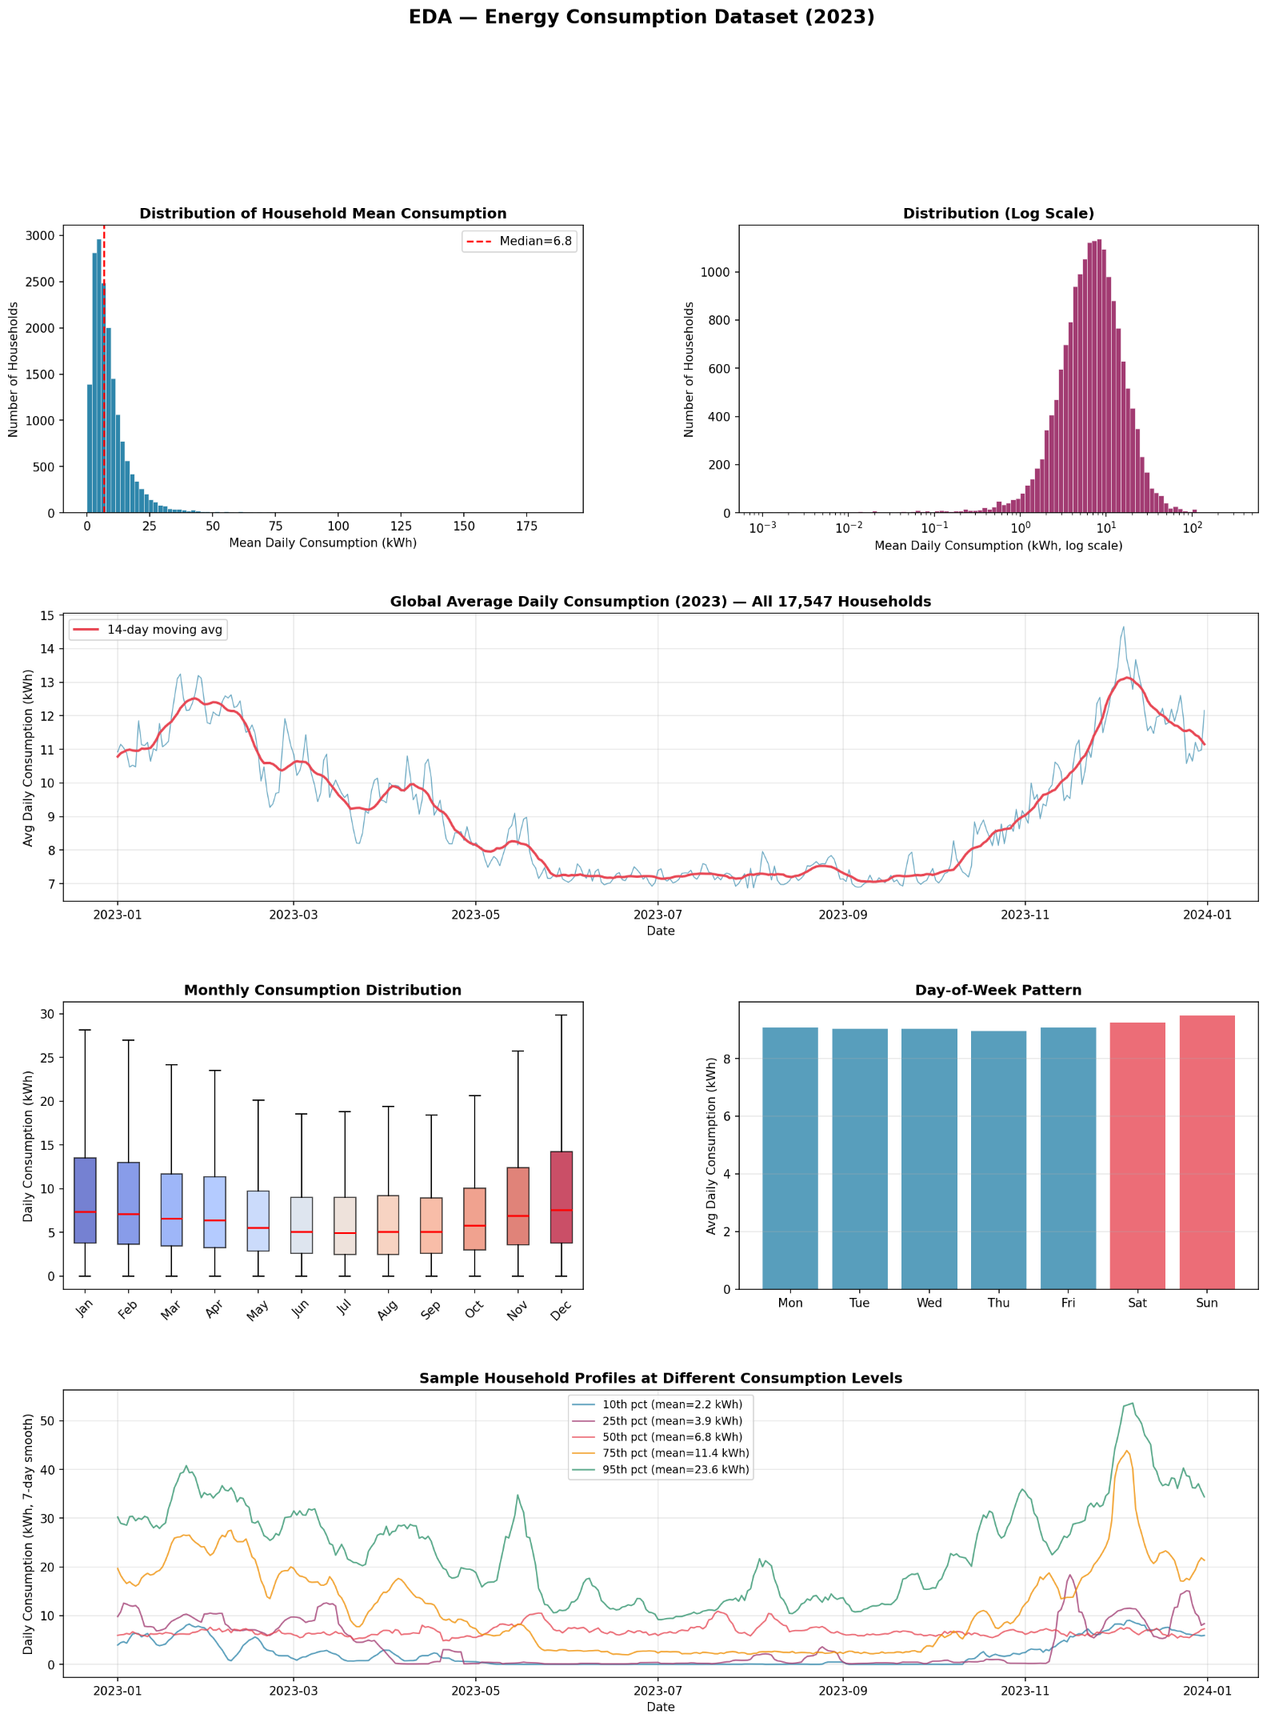
The Data Insight That Changed Everything

Slide 5
What Didn’t Work: ML Models
Method | MAE | Parameters | Time
Seasonal Naive (baseline) | 3.860 | None | 0s
Weekly Naive | 3.294 | last 8 weeks DOW avg, monthly ratio | 0s
Global LightGBM | 3.346 | 47 features, 63 leaves, lr=0.05, 800 trees | 40s
Global XGBoost | 3.392 | 47 features, depth=8, lr=0.05, 800 trees | 950s
Scaled LightGBM (novel) | 3.361 | z-normalised targets, same params | 97s
ML Ensemble (3 models) | 3.339 | inverse-MAE weighted average | 1087s
All ML models performed WORSE than Weekly Naive (3.294)
Why? Low YoY correlation (0.215) → lag_365 feature is noise for 85% of households
Full-year horizon → lag_1 (strongest feature, importance=759) unavailable after Jan 1
No weather data → primary consumption driver is missing
Lesson: Model complexity cannot compensate for weak predictive signal

Slide 6
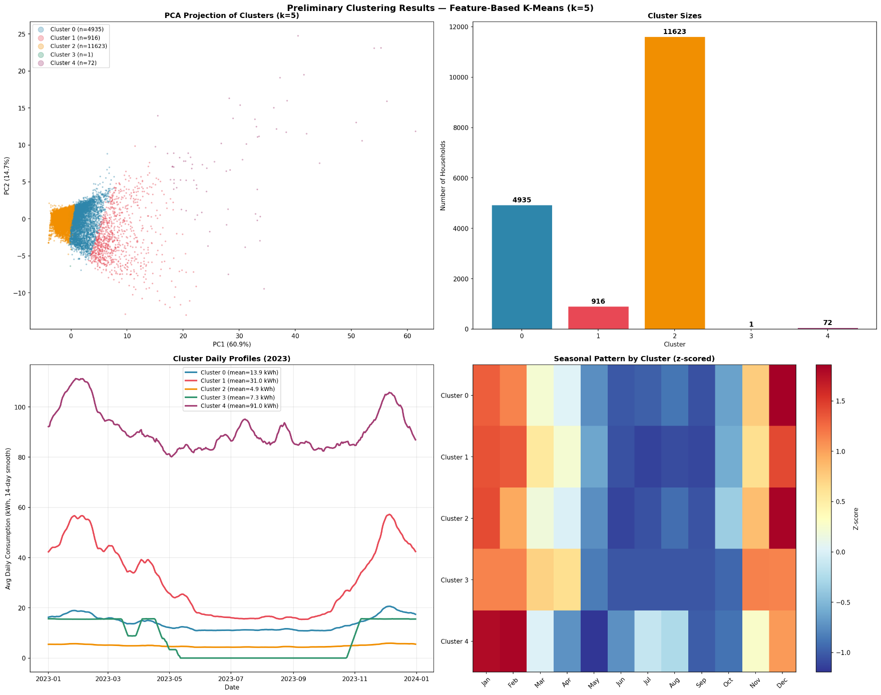
What Partially Worked: Clustering + ML
Three clustering methods tested:
Method | k | MAE
Feature k-Means (raw) | 10 | 3.323
Shape k-Means (z-norm) | 10 | 3.312
Two-Stage (level→shape) | 9 | 3.321
Global LightGBM (no cluster) | — | 3.346
Clustering improved ML by 1.02%
3.346 → 3.312
Shape-based > raw-scale (confirms Paparrizos & Gravano, 2015)
k=10 selected via Davies-Bouldin index (DB=0.90)
Still worse than Weekly Naive (3.294) — clustering helps ML but doesn’t fix the fundamental data limitation

Slide 7
What Worked: Per-Cluster Naive Blend (Our Best Method)
Step 1: Build 6 Naive Predictors
Step 2: Cluster Households
Step 3: Per-Cluster Blend
1. Seasonal Naive (repeat 2023)
2. DOW-Matched (same weekday, closest day)
3. Weekly Naive (8-week DOW avg + monthly ratio)
4. Monthly DOW Profile (12×7 lookup)
5. Exp-Weighted DOW (halflife=3 weeks)
6. Half-Month DOW Profile (24×7)
Feature-based k-Means on z-normalised
32 features (monthly means, DOW means,
autocorrelation, CV, winter/summer ratio)
k=6, StandardScaler, n_init=10
Silhouette validated
For each cluster: find optimal blend
weights via Dirichlet random search
(3,000 iterations per cluster).
Apply 3-day centred moving average
smoothing to final predictions.
Cluster-specific strategies discovered:
Cluster | Top Strategy | Weight | 2nd Strategy | Weight | HH Count
0 | Exp-Weighted DOW | 44% | Monthly DOW | 32% | ~2,900
1 | Exp-Weighted DOW | 32% | Monthly DOW | 29% | ~2,900
2 | Exp-Weighted DOW | 40% | Monthly DOW | 38% | ~2,900
3 | Monthly DOW | 35% | Weekly Naive | 26% | ~2,900
4 | Exp-Weighted DOW | 68% | Seasonal | 12% | ~2,900
5 | Weekly Naive | 47% | Monthly DOW | 23% | ~2,900
MAE = 3.186 | 17.5% better than Seasonal Naive | 4.8% better than best ML

Slide 8
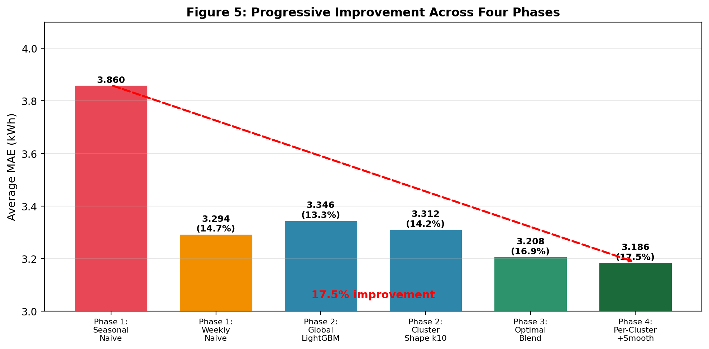
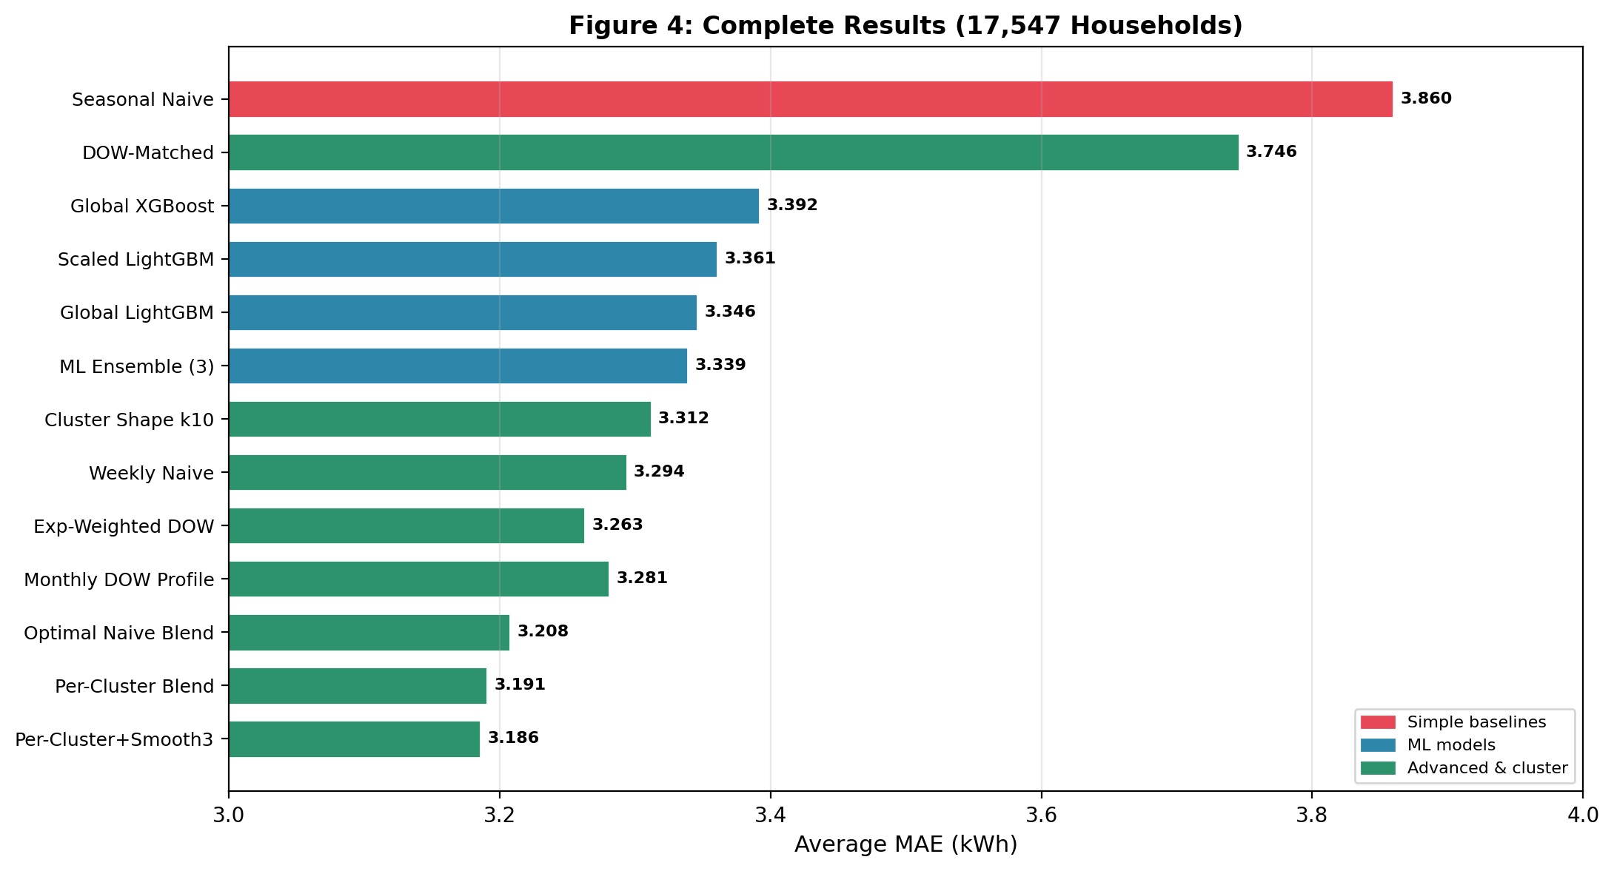
Results: The Full Picture
Per-household MAE computed over 366 daily predictions, averaged across all 17,547 households.
Method | MAE | vs Baseline | Key Parameters
Seasonal Naive | 3.860 | — | Repeat day d of 2023
Weekly Naive | 3.294 | −14.7% | Last 8 weeks DOW avg, monthly ratio to Dec
Global LightGBM | 3.346 | −13.3% | 47 features, 63 leaves, lr=0.05
Cluster Shape k10 + LightGBM | 3.312 | −14.2% | k=10, z-norm features, DB-selected
Per-Cluster Blend + Smooth3 | 3.186 | −17.5% | k=6, 6 naive methods, 3-day smooth

Slide 9
Key Takeaways
Data Analysis > Model Complexity
Clustering Helps — At Both Levels
Discovering 0.215 YoY correlation changed everything. Without this insight, we would have spent all effort tuning LightGBM — which can’t fix a data limitation.
For ML: Shape k-Means improved LightGBM by 1.02% (3.346→3.312). For naive blends: per-cluster weights improved global blend by 0.7% (3.195→3.186).
Shape > Scale for Clustering
Blending Beats Complexity
Z-normalised features → balanced clusters by seasonal pattern. Raw-scale → one dominant cluster (66%). Confirms k-Shape literature (Paparrizos & Gravano, 2015).
Simple method + simple method + ... = strong method. Different households need different strategies. Clustering reveals which strategy works where.
Understanding your data’s statistical properties is more impactful than choosing a sophisticated algorithm.

Slide 10
Thank You
Questions?
Code: github.com/[team-repo]
Muhammad Salman Hafeez • Mikhalchevskyi Yurii • Markschies Benjamin Max

Slide 11
BACKUP: Complete Results Table
Method | MAE | Median | vs SN | Type
Per-Cluster Blend + Smooth3 | 3.186 | 2.14 | 17.5% | Cluster + naive
Refined 6-Method Blend | 3.195 | 2.15 | 17.2% | Global blend
Per-Cluster Blend (no smooth) | 3.191 | 2.14 | 17.3% | Cluster + naive
Optimal Naive Blend (4 methods) | 3.208 | 2.11 | 16.9% | Global blend
Exp-Weighted DOW (halflife=3) | 3.263 | 2.18 | 15.5% | Naive
Monthly DOW Profile (12×7) | 3.281 | 2.18 | 15.0% | Naive
Weekly Naive (8-week, monthly adj) | 3.294 | 2.16 | 14.7% | Baseline
Cluster Shape k-Means k=10 | 3.312 | 2.14 | 14.2% | Cluster + ML
ML Ensemble (LGBM+XGB+Scaled) | 3.339 | 2.16 | 13.5% | ML ensemble
Global LightGBM (63 leaves) | 3.346 | 2.16 | 13.3% | ML
Household-Scaled LightGBM | 3.361 | 2.16 | 12.9% | Novel ML
Global XGBoost (depth=8) | 3.392 | 2.20 | 12.1% | ML
DOW-Matched Naive | 3.746 | 2.57 | 3.0% | Naive
Seasonal Naive | 3.860 | 2.66 | 0.0% | Baseline

Slide 12
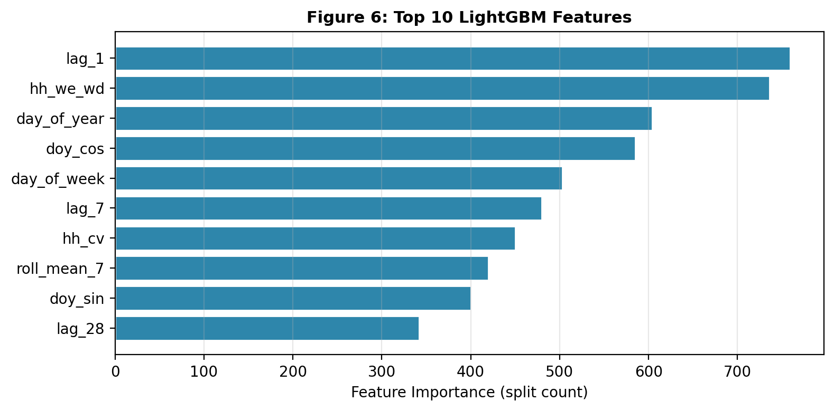
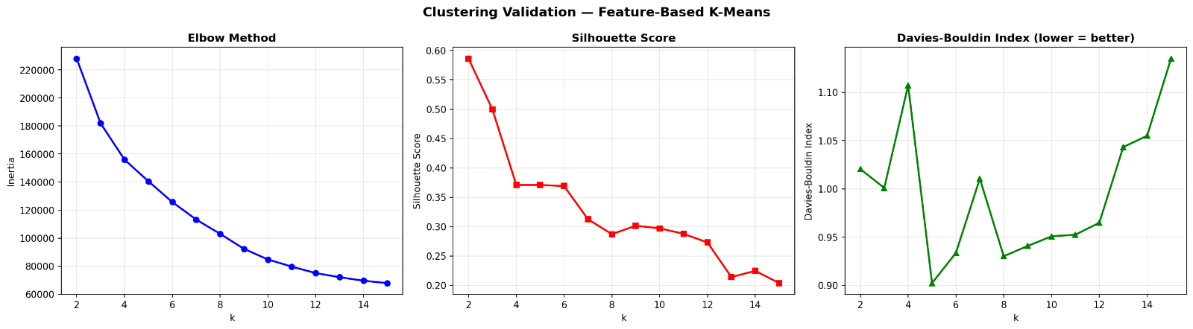
BACKUP: Feature Engineering & Clustering Details
ML Features (47 per observation):
8 temporal: DOW, month, DOY, is_weekend, sin/cos encodings
8 lags: 1, 2, 3, 7, 14, 28, 90, 365 days
5 rolling: mean (7,14,30,90d) + std (7d)
26 household: mean, std, CV, 12 monthly, 7 DOW, winter/summer, trend, we/wd ratio
Clustering Features (32):
12 monthly means + 7 DOW means (z-normalised)
Mean, std, CV, IQR, skewness
Winter/summer ratio, spring/autumn ratio
Autocorrelation lag-1, lag-7, volatility, trend
StandardScaler → k-Means (n_init=10, max_iter=300)

